Slide 1

CT Project Submission
Industrial Human Resource Geo-Visualization
Aravind Chirshtopher Joseph

Slide 2

Problem Statement
In India, the industrial classification of the workforce is essential to understand the distribution of the labor force across various sectors.
The classification of main workers and marginal workers, other than cultivators and agricultural laborers, by sex and by section, division, and class, has been traditionally used to understand the economic status and employment trends in the country.
However, the current data on this classification is outdated and may not accurately reflect the current state of the workforce.
The aim of this study is to update the information on the industrial classification of the main and marginal workers, other than cultivators and agricultural laborers, by sex and by section, division, and class, to provide relevant and accurate data for policy making and employment planning.

Slide 3

Technologies Used
EDA – Pandas , Python
Visualization – Mathplotlib, Plotly , Folium
NLP
Web Application - Streamlit

Slide 4
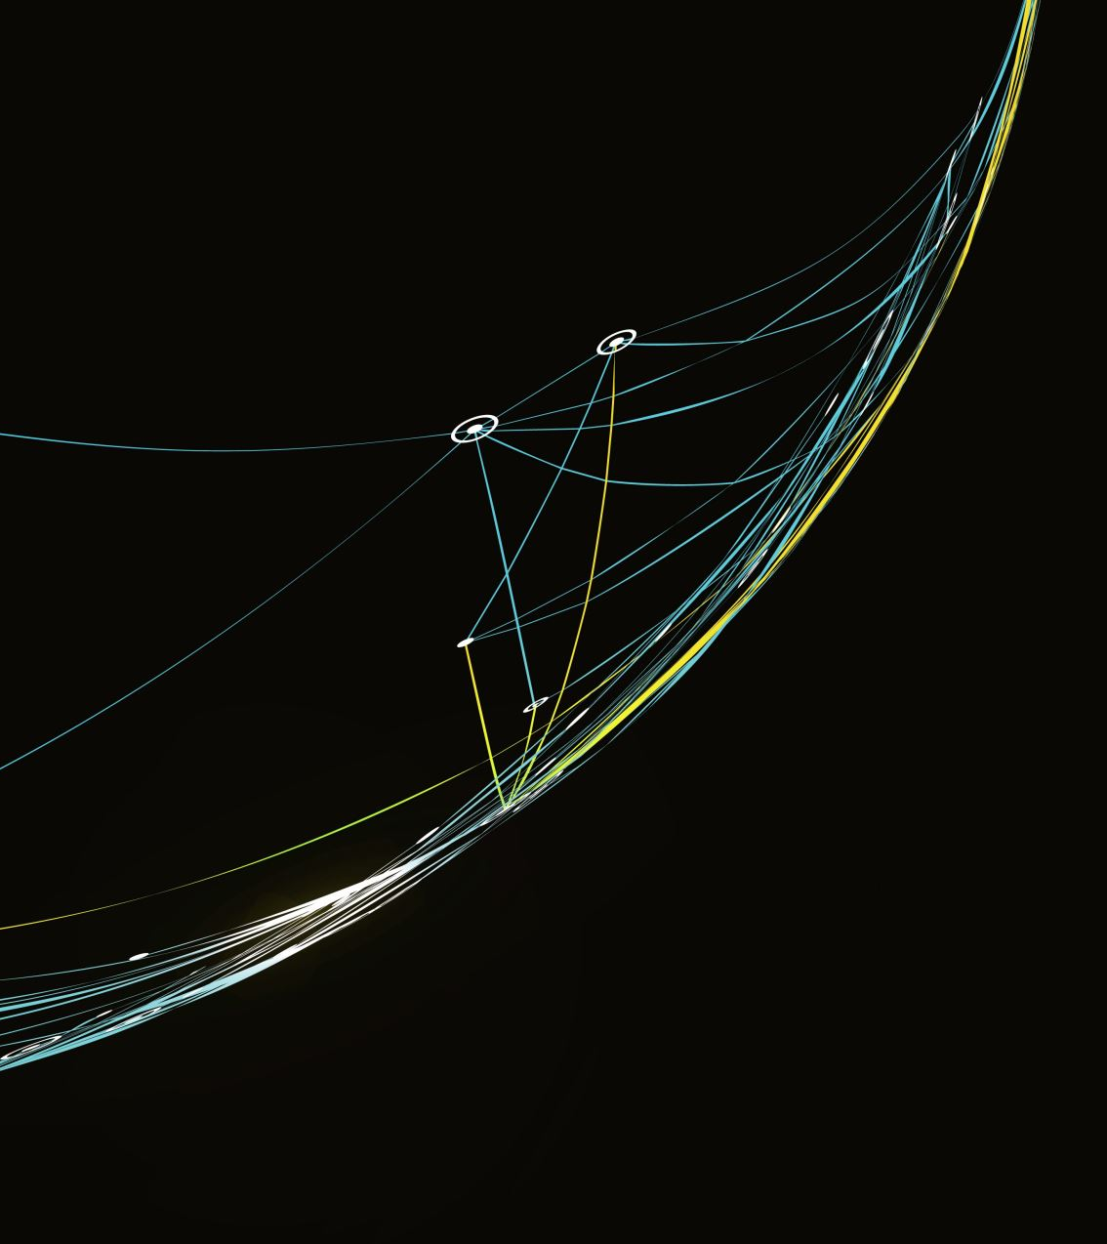
Approaches
Data Importing and Uploading : Use of Pandas to load human resource data from CSV.
Preprocessing Data: Data Cleaning (Removing inconsistencies)
EDA:Removing Duplicates, Null Values, Handling Missing Values
Data Visualization: Visualizing data by Seaborn, Mathplotlib, Plotly and Folium (Geo Visualization)
Data Exploration: By creating user application by Streamlit

Slide 5
EDA
Findings:
No of Main and Marginal Workers in states and Districts
Distribution of workers in rural, main and urban areas.
Male female ratios among workers.
Visualization of marginal workers in rural and urban areas.

Slide 6
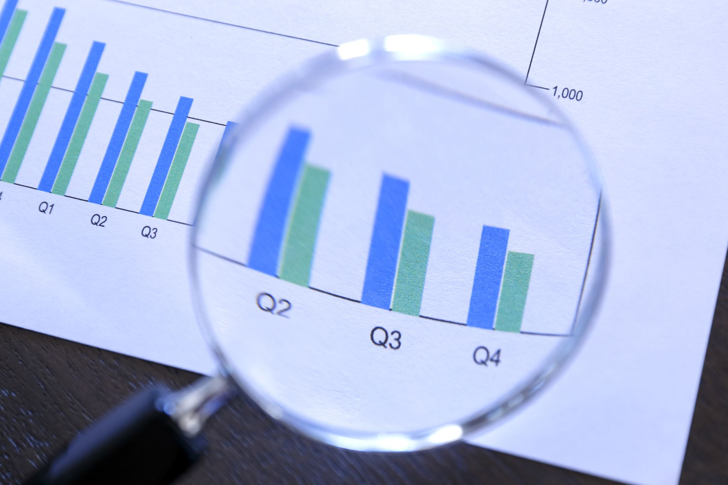
NLP Analysis
Main workers Marginal workers different and Rural and Urban workers.
Various NICName sectors.

Slide 7
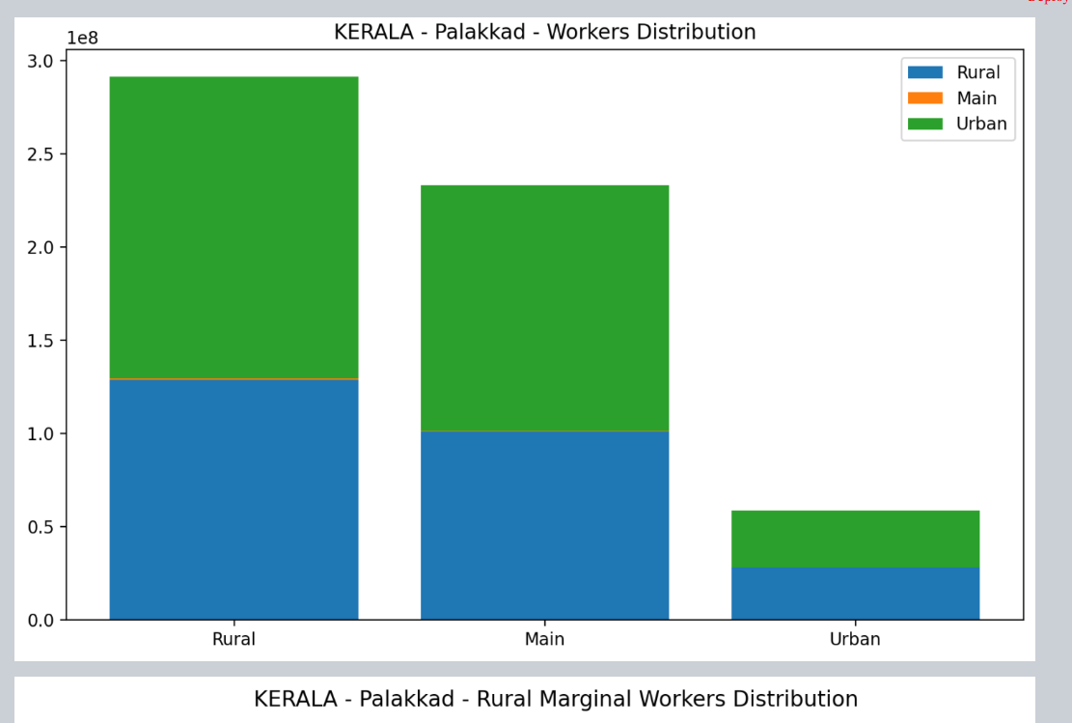
Workers Distribution on Palakkad District from the state of Kerala

Slide 8
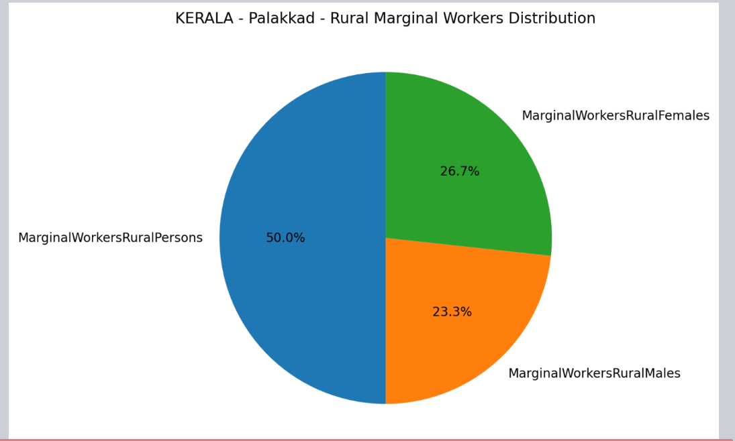

Slide 9
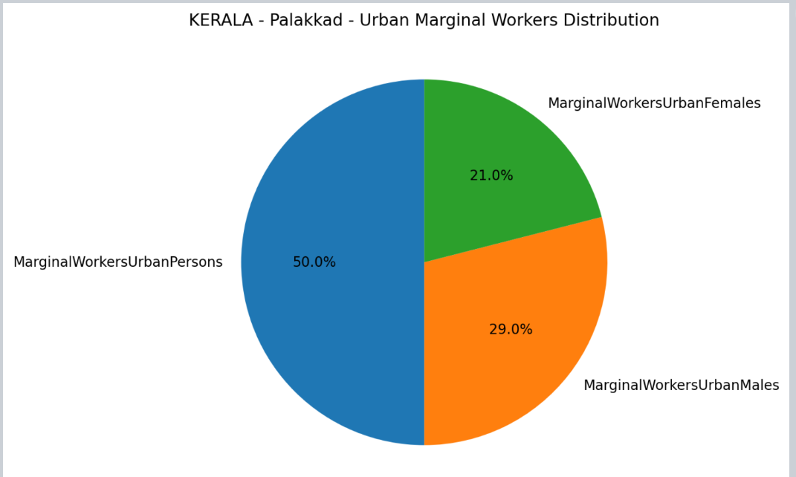

Slide 10
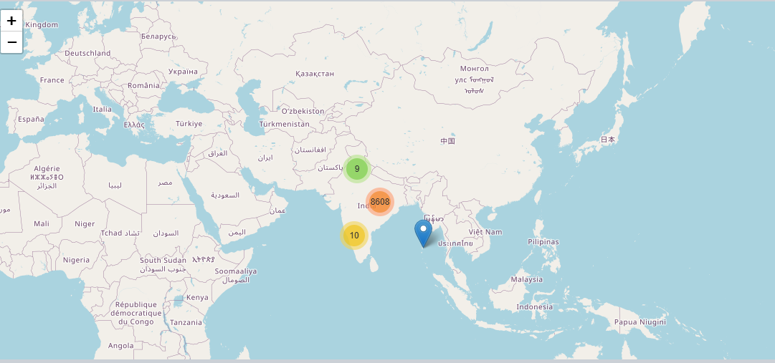
Geo Visualization Using Folium

Slide 11

Thank you

